Slide 1

ELD MANDATE
How to Identify a Compliant ELD
Provider
Kam Roshan
INDIANA STATE TRUCKING ASSOCIATION

Slide 2
Kam Roshan
Product Manager, Compliance, Omnitracs
HOS/ELD, DVIR, IFTA
12 years at Omnitracs Toronto office
User focused, while ensuring compliance

Slide 3
Agenda
Omnitracs
Review of ELD Timeline/Exemptions
Identifying a Compliant ELD
Operational Considerations
ELD Certification Process
Questions

Slide 4
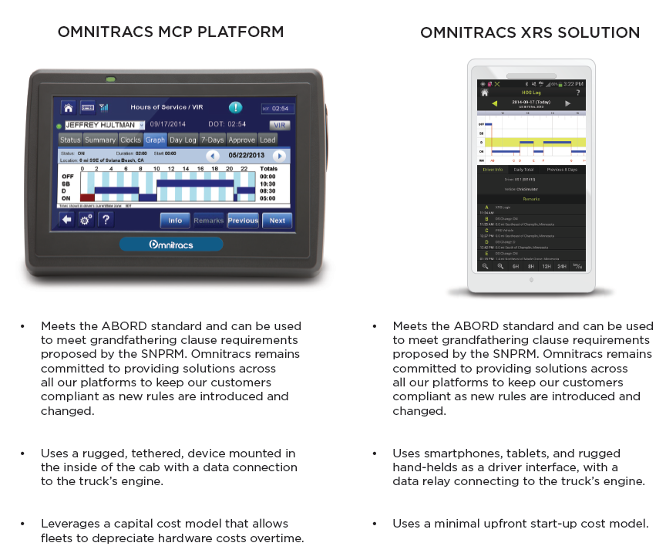
Omnitracs ELD Product Set

Slide 5
Omnitracs and Regulatory
Regulatory - core competency since 1989, servicing fleets with AOBRD compliant devices
  Tom Cuthbertson, VP of Regulatory Compliance
Extremely broad customer base using the systems for compliance in both US, Canada and State Jurisdictions
  Major Private Fleets, Truck Load, LTL, Tank and Flatbed
  Products have capabilities to support O/O, Small Fleets and Very Large Fleets
We have been engaged in all aspects of the regulatory process
  FMCSA – Motor Carrier Safety Advisory Committee EOBR Task Force
  CVSA – Driver Traffic and Enforcement Committee
  ATA – Chair the ELD and Connect the Vehicle Task Forces
  Canadian Mandate for EOBR- Stake Holder
  NHTSA – Currently working on Recommended Practices for V2V

Slide 6
ELD Short Glossary of Terms
AOBRD – Automatic Onboard Recording Device (Current)
DOT – Department of Transportation
ELD – Electronic Logging Device
FMCSA – Federal Motor Carrier Safety Administration
NIST – National Institute of Standards and Technology
PKI – Public Key Infrastructure (Encryption Certificates)
RODS – Record of Duty Status

Slide 7
ELD Mandate Final Timeline
AOBRD | Automatic Onboard
Recording Device
December 16, 2015
Final published
January 16, 2016
Effective date
December 2017
Compliance date
December 2019
Last date to be able to use AOBRD
AOBRD can be installed any time before published date up to the compliance date
Transfer of AOBRD after compliance date to new truck - not allowed

Slide 8
Mandate Exemptions
You are exempt from the ELD Mandate if you…
1. Are classified as a “Short Haul” operator
  “Short Haul”: Use RODS less than 8 days in a 30-day period
  RODS: CDL operators driving outside of a 100-mile radius OR Non-CDL operators driving outside of a 150-mile radius
2. Are classified as a “Drive Away-Tow Away” operation
  An operation in which any Tractor, RV or Motor Home trailer the commodity being transported
3. Drive a truck made before 2000 (according to vehicle VIN#)

Slide 9
Rental Vehicles – Not Exempt
If DRIVER required to keep RODS, need ELD
Length of rental does not matter
Reason for rental does not matter
Rental companies not responsible
  DOT authority is

Slide 10
Identifying a Compliant ELD

Slide 11
Introduction of Events
Certification items – all new
Login/Logout
Power-up and Power-down
Yard Move
Personal Conveyance
Intermediate position
Diagnostic Event
Malfunction Event
Notes:
Can you walk me through how you explain this. I think it is simple but want to make sure. Also what are diagnostic event, malfunction, and intermediate?

Slide 12
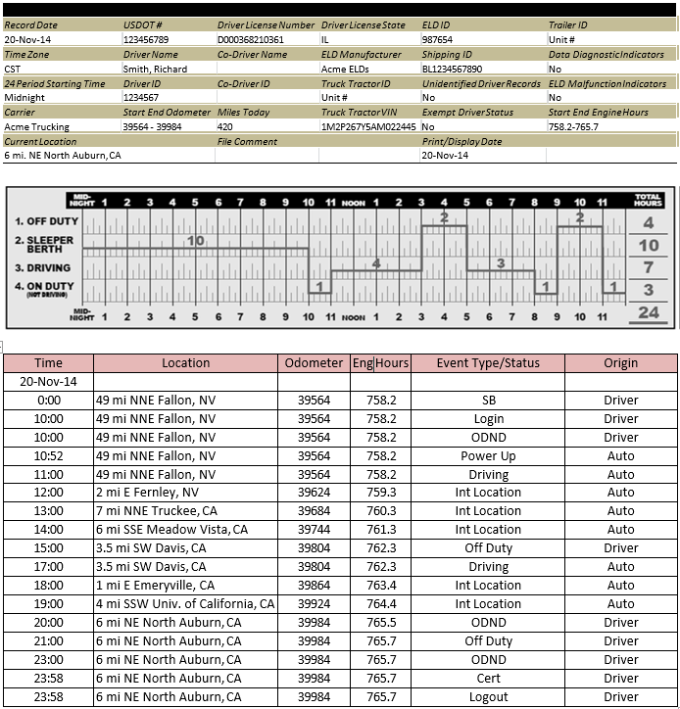
Display Specifications for Enforcement

Slide 13

Identifying a Compliant ELD
Allow Driver to Edit
  Back office to suggest edits
  Driver has control
Driver Certification of Logs
  Login/logout and after edits
Intermediate position reports each hour when driving

Slide 14
Personal Conveyance & Yard Move
Allow administrator to configure for driver use
  Default to Off
Personal Conveyance
  Prompt to continue after vehicle power down
  GPS recording restrictions
Yard Move
  Manually selected and ended
  Recorded as “On Duty” time, not Drive

Slide 15
Display of Personal Conveyance/Yard Move
Dashed, dotted or shaded line
PC shown on off duty line
Yard Move shown on duty

Slide 16
Unassigned Driving Time
Unassigned Driving – Presented to Driver
What are operational causes?
  Driver forgets to login
  Mechanic road test
  Relocating tractor to another yard not by driver
Correction after the fact
  Upon login, a driver is prompted to accept or decline unassigned driving time
  Any declined time must be reconciled by carrier by annotating the record

Slide 17
Auto Duty Status
Drive – From any other duty status to Drive
  When motion is detected and the speed reaches a maximum of 5 MPH
  There is NO TIME / DISTANCE consideration
On-Duty – From Drive
  After 5 minutes of no motion detected
  Prompt after 1 minute
No other auto duty status changes allowed

Slide 18


eRODS File Transmission
Enforcement can request driver to enter phrase – driver selection of method in category
eRODS file needs to be generated on the mobile device
Telematics Transfer Method
Web Services
Email SMTP
Peer to Peer Transfer Method
Bluetooth Web service local network
USB 2.0
Or

Slide 19
Security Compliance
Telematics Transfer Method
Web Services
Email SMTP
Peer to Peer Transfer Method
Bluetooth
USB 2.0
Web Service and email
  FIPS publication 197
  NIST SP 800-32
  Web service – Soap
  PKI registered with FMCSA
Bluetooth
  Discoverable
  Generate random code
USB thumb drive
  AES – 256 Security

Slide 20
Malfunctions and Diagnostics
Diagnostics trigger malfunctions
Malfunction Code | Description | Duration in 24 hours
P | Power Compliance | 30
E | Engine Synchronization | 30
T | Timing | Calibrate UTC
L | Position | More complex
R | Data Recording
S | Data Transfer | 7 day test cycle
O | Other
 | Unidentified driving record | Diagnostic only

Slide 21
“Under the Covers” Technical Items
Motion must be detected no more than 5 MPH
Stop of drive must be detected no more than 3 seconds
Limits on recovery of ECM 5 seconds
Exempt Driver – recording of motion segments
Data for locations, GNIS data base with population 5000 and greater – minimum requirement for consistent names – can be more

Slide 22
Operational Considerations

Slide 23
ELD MANDATE – 3 Most Important items
Three most important for training and awareness
Editing of Logs
  Carrier and driver
Unassigned Vehicle Moves
  Driver and Carrier- Audit considerations
Yard Moves
  Manual event

Slide 24
New Functions for Drivers
Driver could be warned of several diagnostics
  Malfunctions result in paper log
Driver will have process for enforcement transfer
  Will interact with enforcement
Driver has the ability to enter city, state location if
GPS issue
Unassigned Activity
Carrier Edits

Slide 25
Key Elements for ELD Administrators
Setting up of drivers, exempt drivers and secure access
Review edits that are rejected by driver
Driver rejected unassigned drive - reconcile
Review of malfunctions in vehicles
Setting of yard move and personal conveyance
VIN numbers entered if vehicle cannot provide

Slide 26
Training at the Carrier - Who?
  Dispatch – Better information on availability
  Safety – Need to establish policy for ELD compliance
  Driver – Need to know how to use systems, changes and responsibilities
  Driver Managers – Driver assistance
  Maintenance – Device can only be out of service 8 days

Slide 27
Why establish Policy?
Prohibition of Coercion rule issued with ELD Mandate
Policy for preserving hours of service documents
    Editing of logs and process
    Driver annotations on logs
    Reviews of driver concerns on log edits
    Making sure devices are functioning

Slide 28
ELD Certification

Slide 29
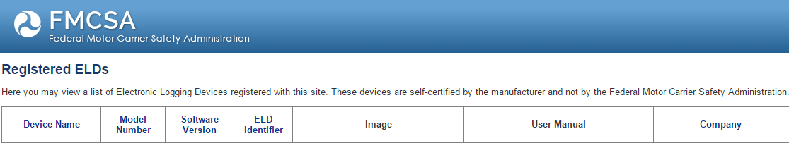
ELD Certification Process
Shortcomings of the Process
Anyone can claim to be certified
Anyone can register an ELD
If FMCSA finds that an ELD listed on its website doesn’t comply with technical specifications, they may initiate removal of an ELD model or version from its list by providing written notice to the ELD
By then it may be too late for the carrier, may have spent tens of thousands of dollars
454-page test document to pass

Slide 30
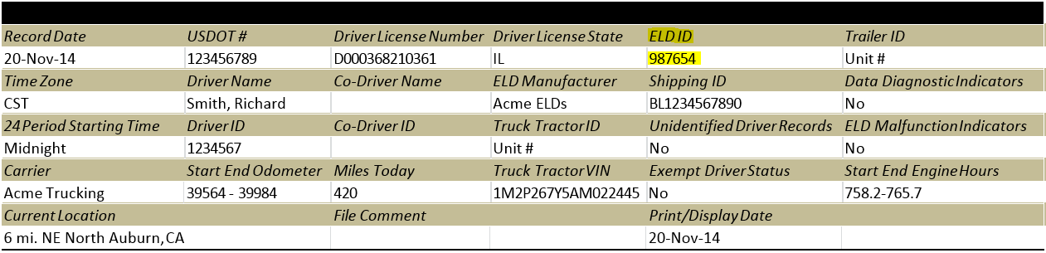
ELD Certification Process
FMCSA will provide
  Authentication key(s)
  Authentication file(s)
  Registration number
  Used in ELD log file for verification
Currently available for certification

Slide 31
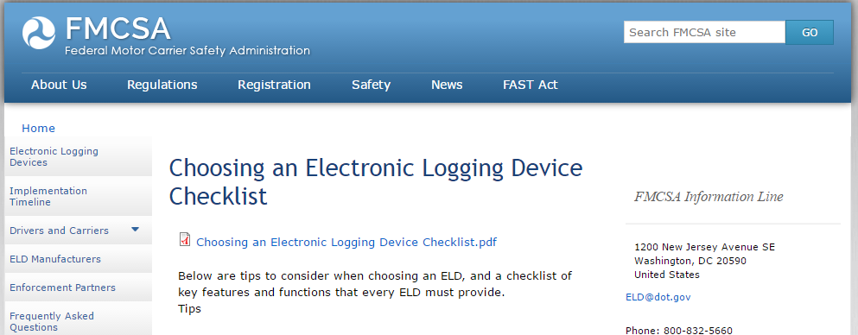
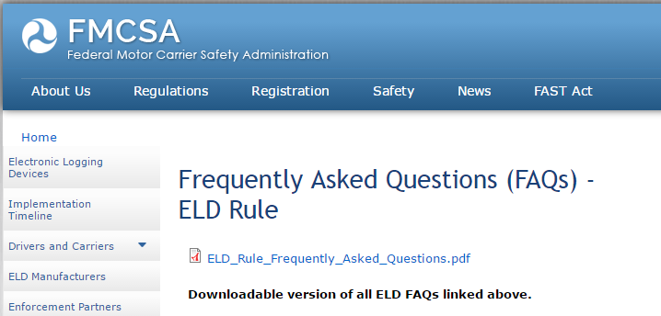
FMCSA Website

Slide 32
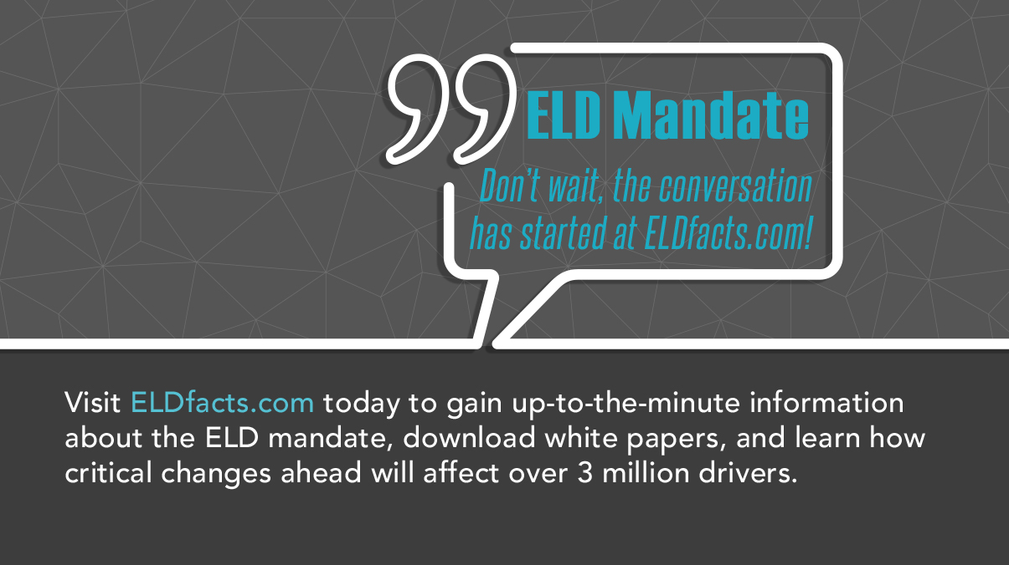
Stay Up to Date
ELDFacts.com

Slide 33
Questions?

